Slide 1
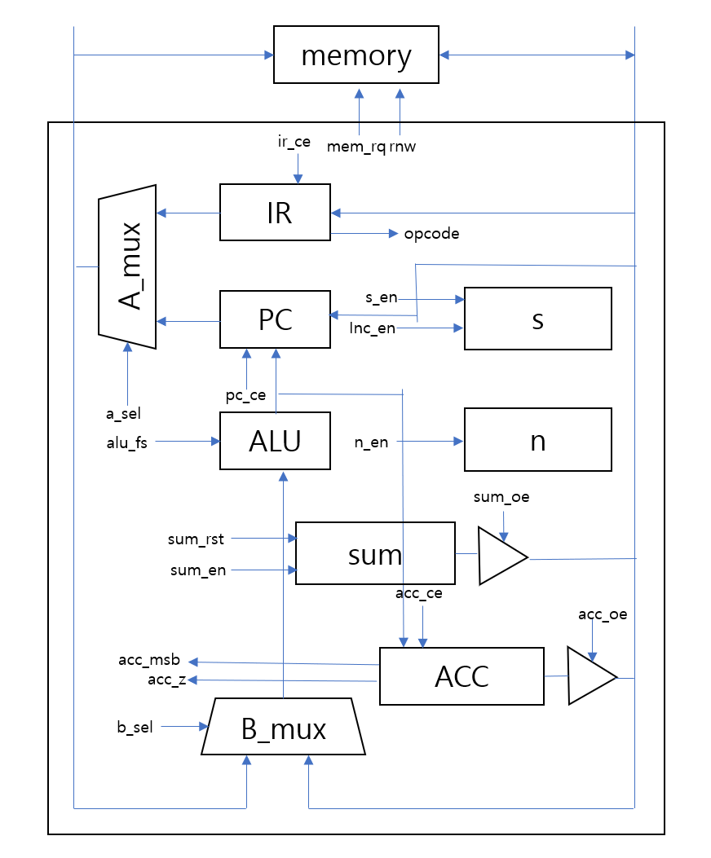

Slide 2
memory
Mu0
ir_ce
mem_rq
rnw
1
IR
A_mux
opcode
0
PC
pc_ce
ALU
acc_ce
a_sel
alu_fs
b
a
acc_oe
acc_msb
ACC
acc_z
n_en
n
comp
comp_sn
b_sel
B_mux
0
1
16’h0001
s_en
inc_en
+
s
sum_rst
sum_en
sum_oe
+
sum

